Slide 1


Analysis of Football Players by using EA FIFA 21 database
597 FINAL PROJECT
Haoyuan Zhong

Slide 2


Slide 3

Overall goal
My goal for this project is to identify the most important abilities and specialties for different football player’s position and help gamer and real-life football club to improve the club squad, and to have a better winning record.

Slide 4
Data resource
Data from Scraping
Data from Kaggle

Slide 5
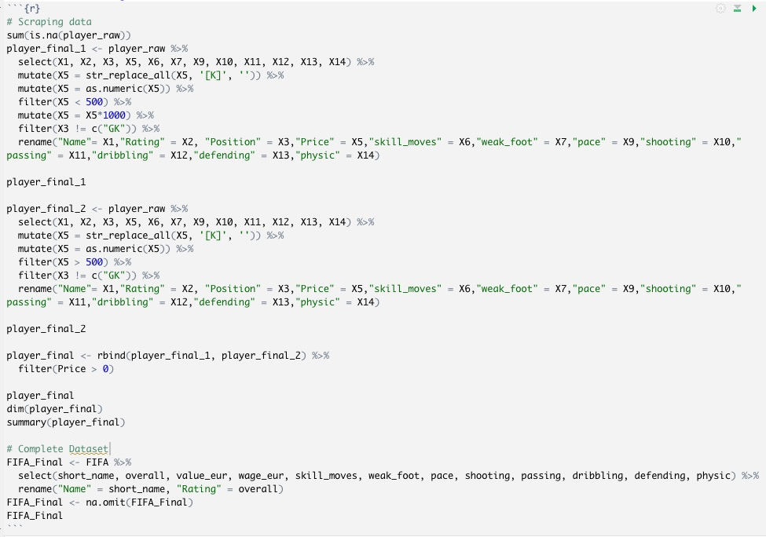
Data cleaning

Slide 6
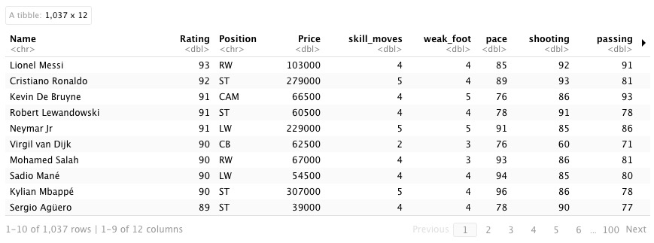
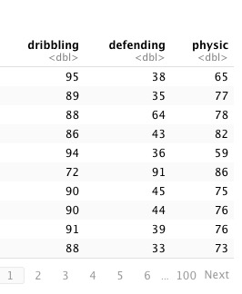
Dataset from Scraping

Slide 7
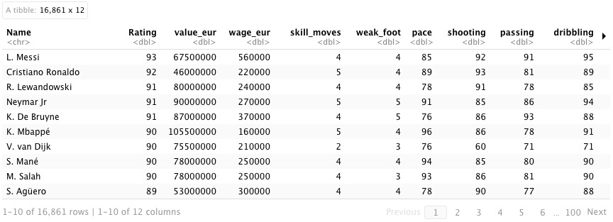
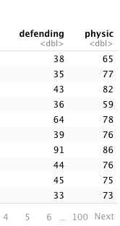
Data from kaggle

Slide 8
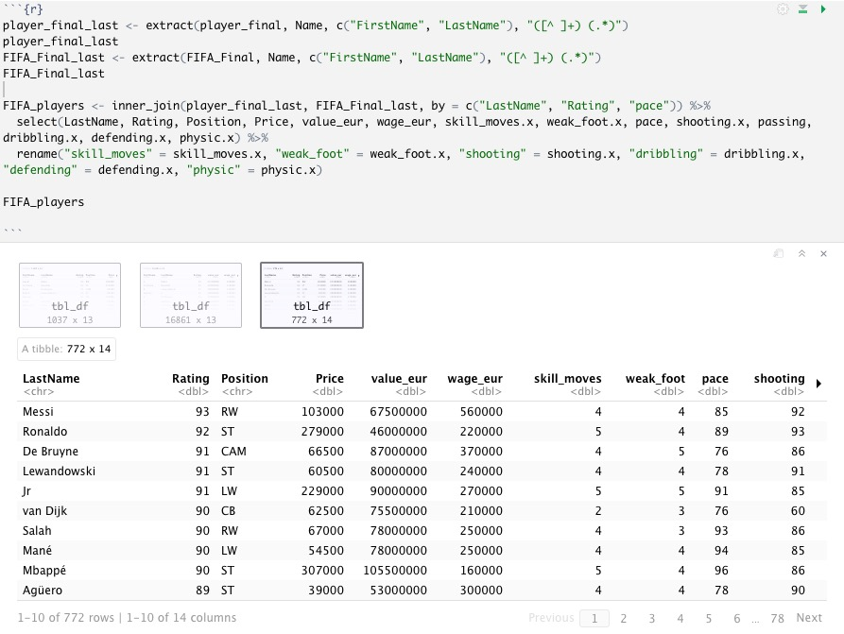
Join on these two datasets

Slide 9
Exploratory data analysis
Distribution of price, value, and wage
Rating vs. price, value, and wage
Count for different positions
Attacker
Winger
Full back
Defender
Midfielder

Slide 10
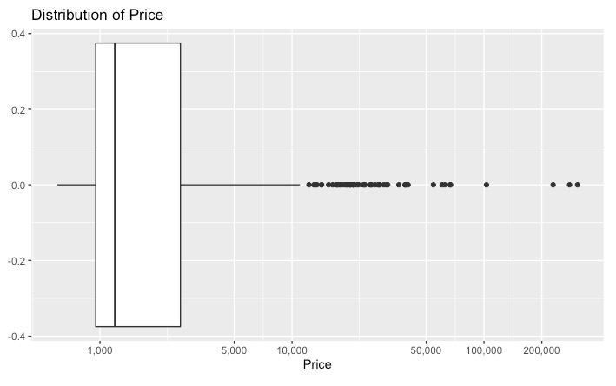
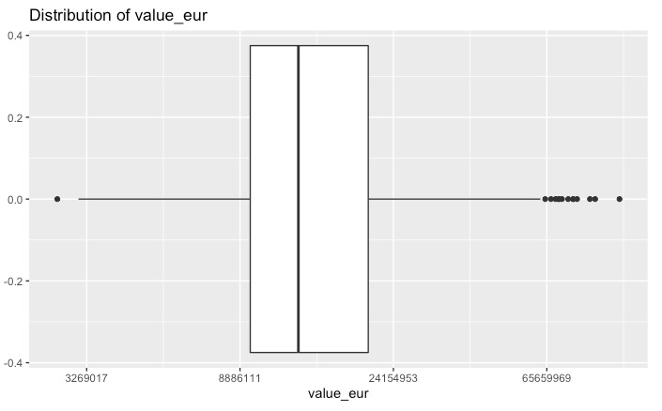
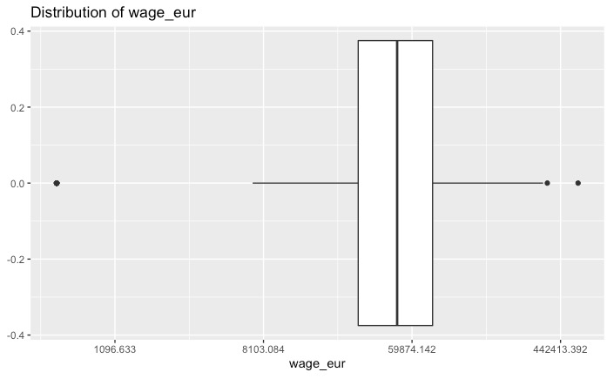
Distribution of price, value, and wage

Slide 11
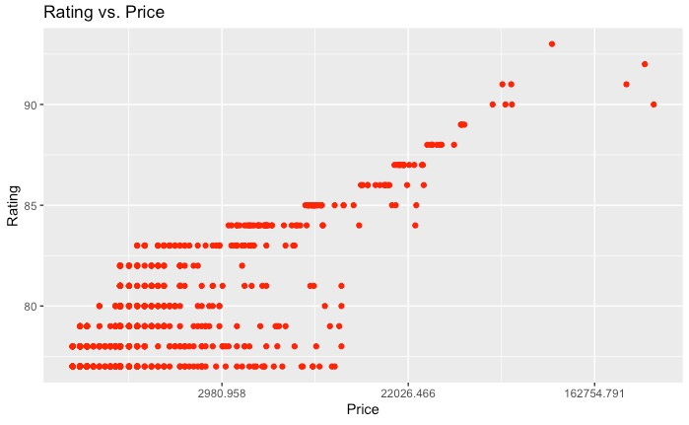
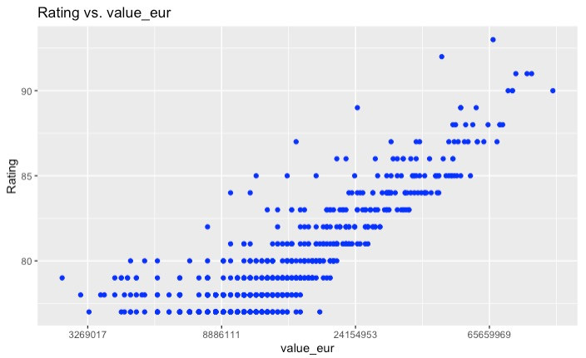
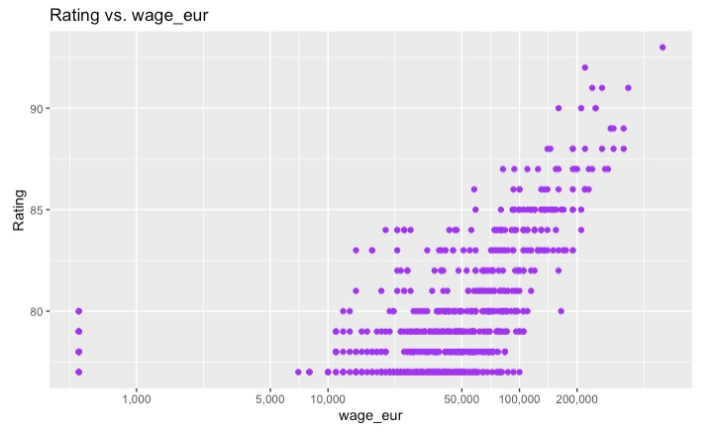
Rating vs. price, value, and wage

Slide 12
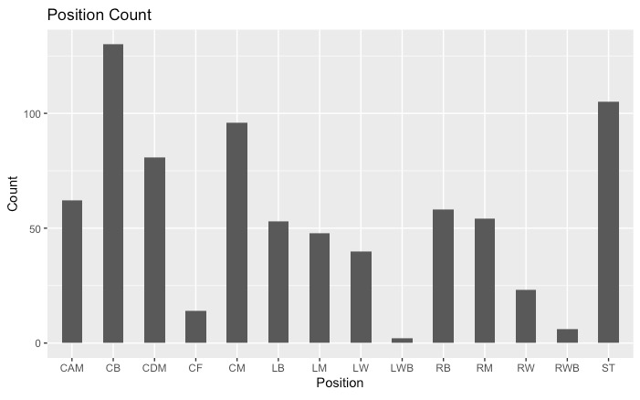
Count for different positions

Slide 13
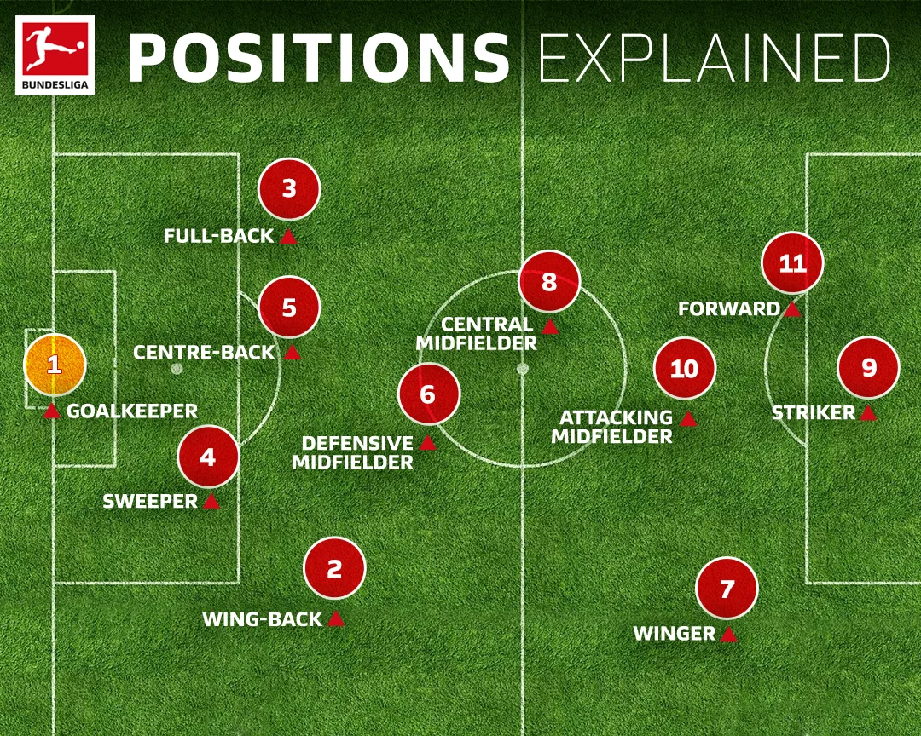
Football/soccer 101

Slide 14
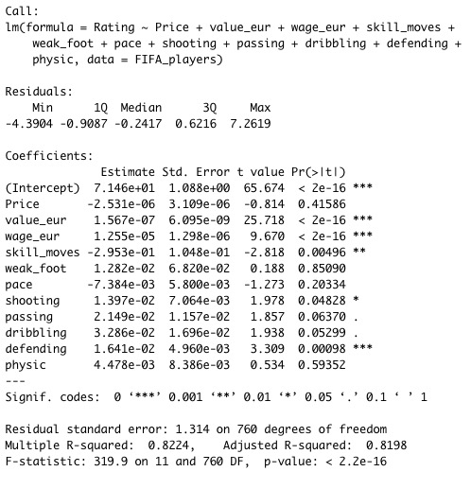
Linear model summary

Slide 15
Thank you

Slide 16
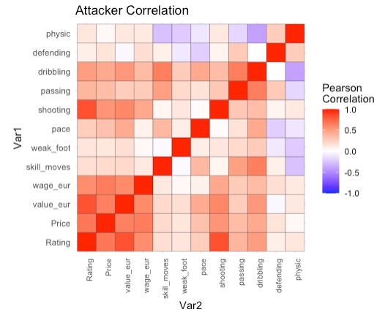
attacker
Back

Slide 17
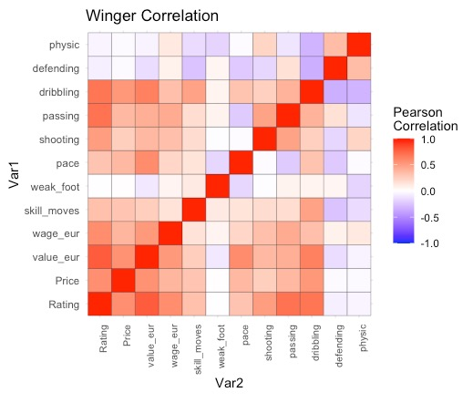
winger
Back

Slide 18
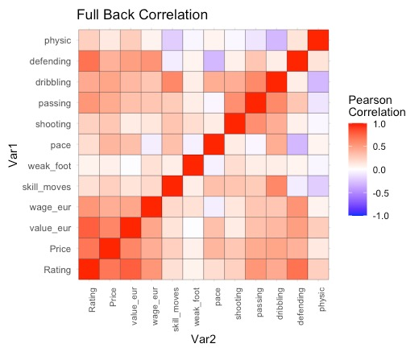
Full back
Back

Slide 19
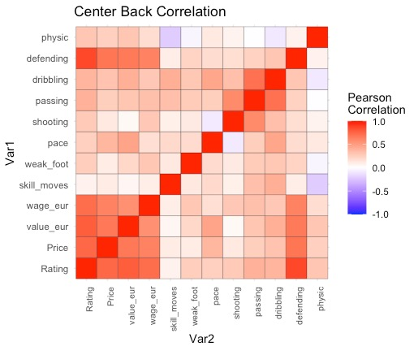
defender
Back

Slide 20
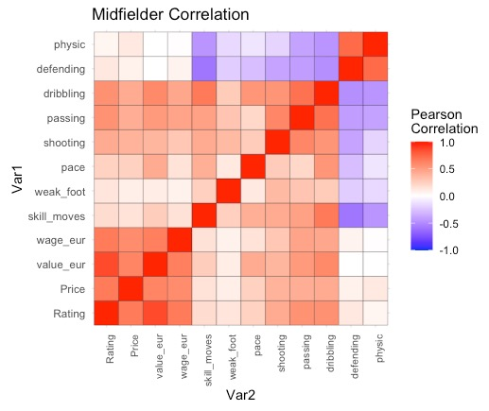
midfielder
Back

